Slide 1
Office of Pipeline Safety Pipeline and Hazardous Materials Safety Administration Overview
RRT5
Spring 2018
Grand Rapids, MI

Slide 2
Objective
Introduce PHMSA
Establish an understanding how PHMSA can be a resource
Introduce PHMSA’s Accident Investigation Team
National Pipeline Incident Coordinator (NPIC)
NPIC toll-free: (888) 719-9033
811

Slide 3
Who is the U. S. Department of Transportation (DOT)
National Highway Traffic Safety Administration (NHTSA)
Federal Aviation Administration (FAA)
Office of Inspector General (OIG)
Federal Highway Administration (FHWA)
Federal Motor Carrier Safety Administration (FMCSA)
Federal Railroad Administration (FRA)
Saint Lawrence Seaway Development Corporation (SLSDC)
Federal Transit Administration (FTA)
Maritime Administration (MARAD)
Pipeline and Hazardous Materials Safety Administration (PHMSA)
Office of Hazardous Materials
Office of Pipeline Safety

Slide 4
PHMSA (OPS) Pipeline role
PHMSA does not have response authority
Regulates interstate pipelines
Natural Gas
Hydrocarbons
Ammonia
Carbon Dioxide
And more

Slide 5
US DOT Regulated Pipelines in RRT 5

Slide 6
PHMSA Reporting requirements
PHMSA has NRC reporting requirements for pipeline systems
Initial (within earliest practical moment following discovery but no later than 1 hour
Gas
An event involving a release of gas
A death, or personal injury necessitating in-patient hospitalization
Greater than $50,000 estimated property damage
Unintentional estimated gas loss of 3 million cubic feet or more
An event that results in an emergency shutdown of an LNG facility or natural gas storage facility
An event that is characterized as significant by operator
Hazardous Liquids
An event involving the release of a liquid
A death, or personal injury necessitating in-patient hospitalization
Incident involved a fire or explosion
Greater than $50,000 property damage including the cost of the cleanup, value of product
Resulted in pollution of any stream, river, lake, reservoir or similar body of water
An event that is characterized as significant by operator
48-hour
Must provide an update to confirm/revise initial information reported.

Slide 7
Available PHMSA OPS resources
Have agreements and partners with States to implement rules
PHMSA has PREP guidelines
PHMSA regulates pipeline operators readiness and response effectiveness
PHMSA has FRP repository for pipelines
Often fixed facilities are also regulated by EPA and/or USCG
Available to OSCs by request
Made up of primarily field staff
Highly technical
Engineers and Transportation Specialist

Slide 8
PHMSA Accident Investigation Division (AID) Motto: Investigate – Analyze – Prevent Established April 1, 2017

Slide 9
PHMSA Accident Investigation Division
PURPOSE
Evaluates all reports of incidents/accidents
Investigates all PHMSA regulated pipeline incidents
Consider details of report
Conducts Accident Investigations
Conducts Root Cause Determinations to determine casual and contributing factors to pipeline and liquefied natural gas facility incidents
Captures and actively shares lessons learned safety finding with internal and external stakeholders.
Conducts education and outreach to help advance pipeline safety
Evaluates and identify emerging safety trends
Coordinates incidents with state and federal partners

Slide 10
National Pipeline Incident Coordinator (NPIC)
NPIC toll-free: (888) 719-9033
PHMSAAccidentInvestigationDivision@dot.gov
Staff Mobile Numbers:
Peter Katchmar: 303-807-8458
Chris Ruhl: 405-590-3625
Brian Pierzina: 816-589-8293
Alex Colletti: 405-403-0541
Michael Jones: 405-403-0546
Darren Lemmerman: 816-807-2606
Gery Bauman: 440-725-7043
Julie Halliday: 202-389-2039

Slide 11
Deployment Criteria
A release of product and one or more of the following:
✓ Death
✓ Personal injury necessitating hospitalization
✓ Property damage exceeding $500K
✓ Hazardous liquid spill of 500 or more barrels
✓ Fire or explosion
✓ Major spill into a body of water
✓ Pipeline systems with recent failure history
✓ Significant media attention
✓ Release impacted:
- an HCA
- High Population Area
- Other Populated Areas
- Commercially navigable waterway, or major waterbody
- Unusually Sensitive Area (USA) ‐ (drinking water resource, ecological, threatened species)

Slide 12
Opportunities to work together
Pipeline FRPs
Preplanning
RRTs
PREP Drills
Incident coordination
Situational awareness
Common Operating Picture
Leverage resources
Pipeline mapping
Operator Contacts and Coordination
Evidence collection

Slide 13
Opportunities to work together
Opportunities to work together
Investigation
Equipment
Process
RP response effectiveness
Pipeline Operation
Training
Pipeline expertise
Disaster Response
Pad set up and waste packaging
Hazmat transport waivers
NTSB Investigation liaison

Slide 14
NRS Notification & Decision Process
Incident Occurs
Notification
National Response Center
Notification
Initial Assessment/
First Response
Federal/State/Local/RP
Notification Response Measures
Natural Resources Trustees
On-Scene Coordinator (OSC)
Notification
Federal Response Required?
State/Local/RP Response
NO
PHMSA
YES
PHMSA
NRT
RRTs
OSC
Special Teams
Available to support OSC on request
Available to support OSC on request
State/
Local/Tribal
RP
(Unified Command Structure, as developed by the Area Committee)
Notes:
This is an overview of how some of the key NRS components fit together during the response process.
As explained earlier, federal law requires responsible parties to report spills of oil and hazardous substances to the National Response Center.
The National Response Center then forwards these notifications to the pre-designated federal OSC assigned to the area for the incident. The NRC also forwards these notifications to other appropriate federal and state entities, including the DHS National Operations Center.
The OSC gathers information about the incident in order to determine whether a federal response is warranted. The OSC may gather information via phone from state and local agencies and the responsible party, or may deploy to the site to collect information, depending on the incident.
If the incident impacts resources overseen by a federal or state natural resource trustee, the OSC would also notify that trustee.
An OSC may determine that a federal response is not required if appropriate actions are already being taken by a state or local agency or the responsible party and the release doesn’t constitute a significant public health or environmental threat.
If a federal response is warranted, the OSC typically enters into a unified command with responding state/local agencies, and possibly the responsible party when appropriate.
The OSC may call upon other NRS assets for assistance as needed, including the federal special teams, the RRTs, and NRT.

Slide 15
Where does PHMSA’s role in ICS
Agency Representative
Operations
Investigation
Public Information Officer
Technical Specialist
Operates outside ICS

Slide 16
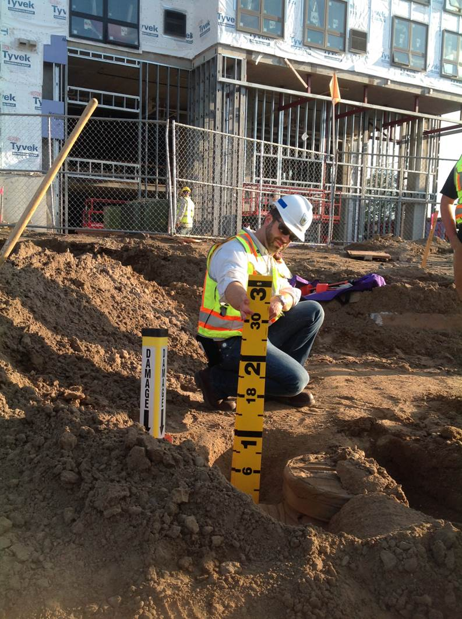
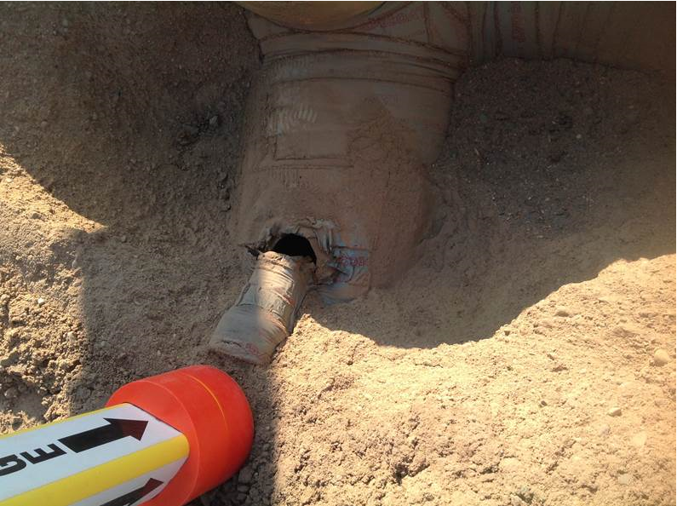
8/7/17, Minneapolis, MN
3rd Party Damage
100+ people evacuated (60 kids)
Stub knocked off by bulldozer 3’ below grade. Pipeline was marked earlier in the day.

Slide 17
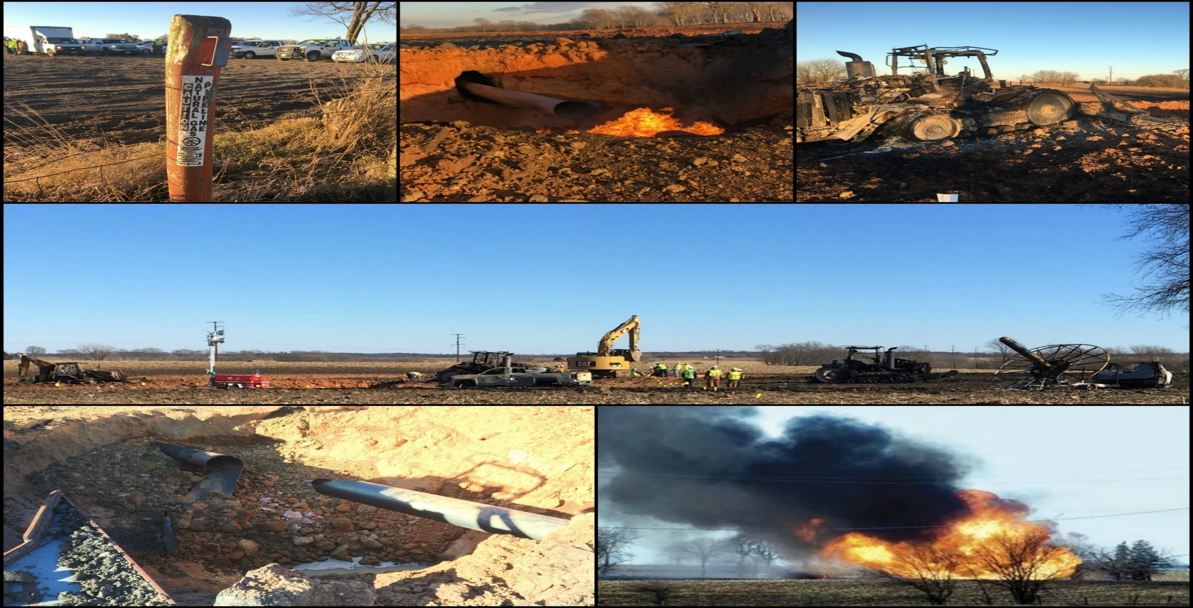
Natural Gas Pipeline Explosion
Dixon, IL
Occurred when agricultural equipment struck pipeline
2 fatalities, 2 injuries

Slide 18
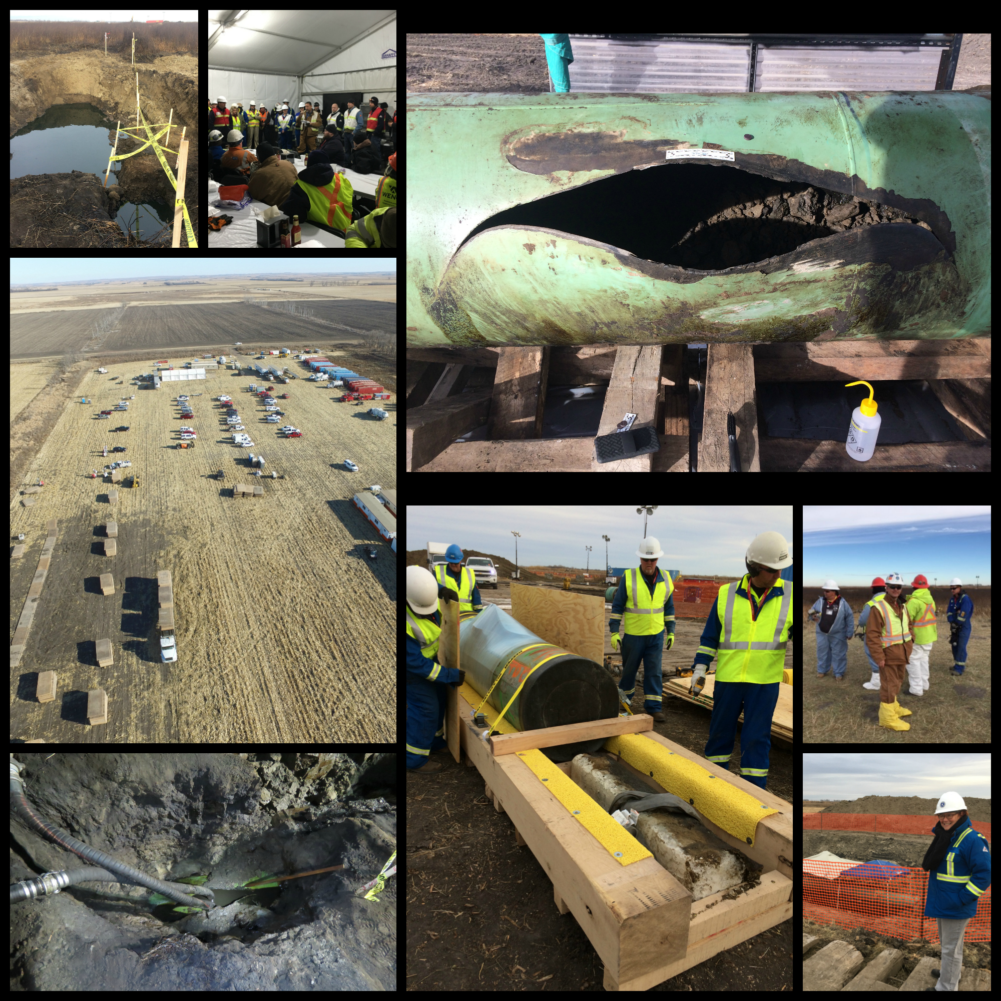
Amherst, SD 5,000 barrels of crude oil spilled EPA R8 deployed

Slide 19
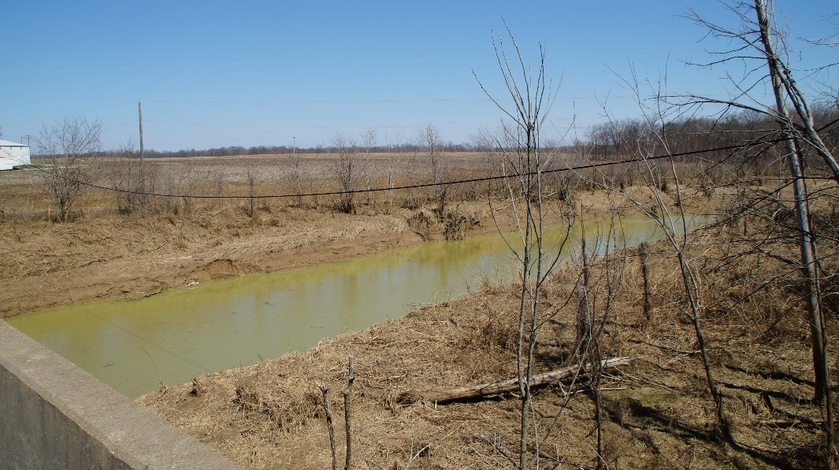
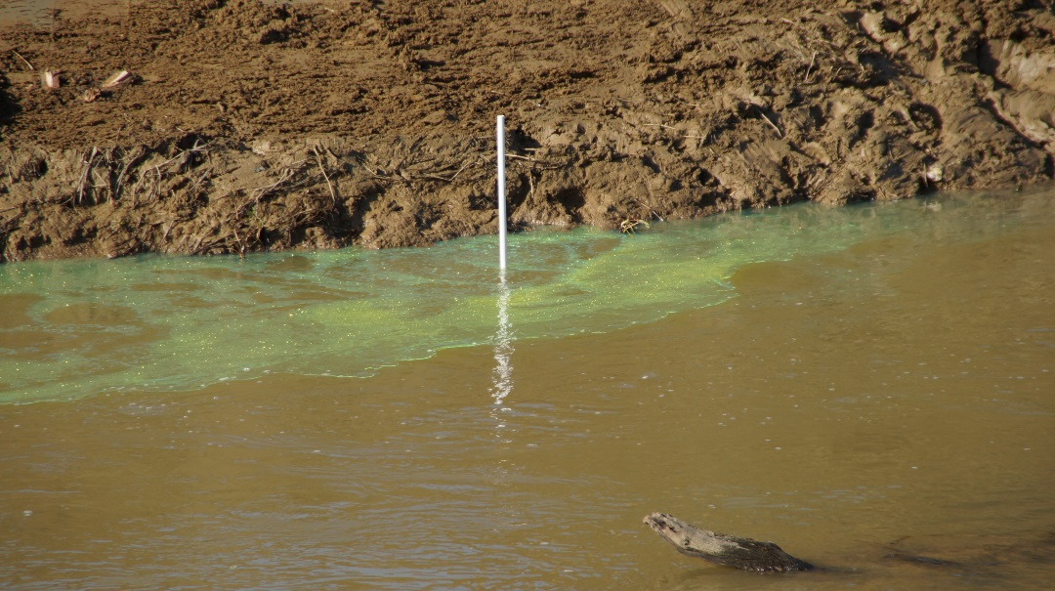
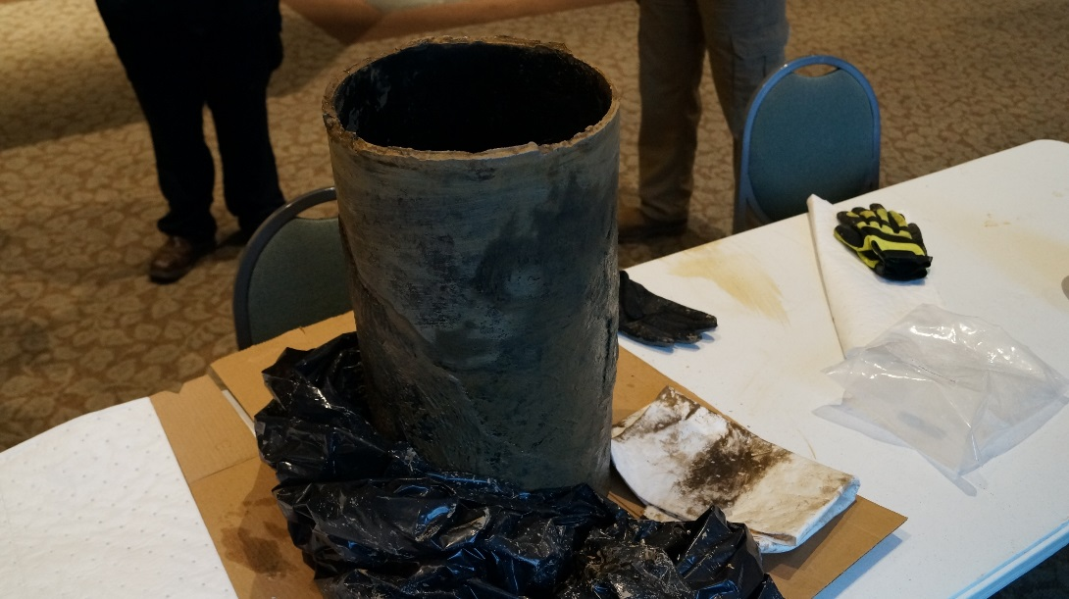
Solitude, Indiana 1400 barrels Diesel EPA R5 Deployed

Slide 21
PHMSA Regional Offices

Slide 22
Office of Hazardous Materials
Central Region Field Operations
Director Tyler Patterson (816) 329-3815
Chief Investigator Tiffany Ziemer
Investigator Mark Razny Investigator Ted Turner
Investigator Tim Buffum Investigator Shirley Mcnew
Investigator Dan Richards Investigator Mike Jennens
Outreach and Engagement (HMSAT)
Neal Suchak (202) 839-0498; neal.Suchak@dot.gov
Central Region Office, Kansas City, MO (816) 329-3802
DOT Crisis Management Center: (202) 366-1863
22

Slide 23
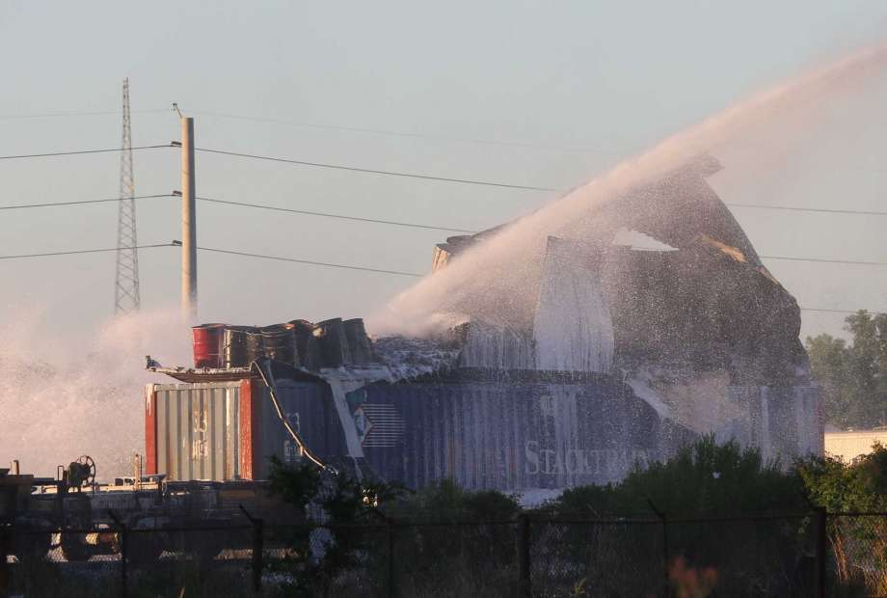
Hazardous Materials Accident Investigation Team Pilot Program

Slide 24
Background
PHMSA’s Office of Hazardous Materials Safety initiated a root cause-based accident investigation pilot program to evaluate feasibility and viability of a full-time accident investigation team.
The Purpose for the pilot program:
Become proactive instead of reactive towards accidents and their prevention
Make safety recommendations to deter future accidents
Track and respond quickly to emerging trends
Establish specialized and recurrent root cause training for investigators
24

Slide 25
Objectives
Improving accuracy & relevance of PHMSA data collection efforts
Identifying emerging risks & recommending agency action (outreach & engagement, rulemaking, etc)
Developing safety recommendations
Establishing root case-based accident training curriculum
Enhancing risk-analysis through data-driven, innovative tracking of emerging trends and near misses
Sharing accident data recommendations & lessons learned with internal & external stakeholders, including DOT modal partners

Slide 26
Pilot Benefits
Advancing quality of investigations by strengthening full-time investigator expertise through comprehensive root cause analysis training
Determining robust standardized processes to improve data collection, analysis & validation
Strengthening stakeholder outreach efforts & partnerships (OHMS, DOT modal partners, external stakeholders)
26

Slide 27
PHMSA Emergency Contact Information NPIC toll-free: (888) 719-9033 PHMSAAccidentInvestigationDivision@dot.gov DOT Crisis Management Center (202) 366-1863 Investigate – Analyze – Prevent

